Slide 1
Lessons Learned from Standard of Care, First Generation and Next Generation Biotherapeutics: What Do We Expect to Change Going Forward ?
Steven J Swanson, PhD Executive Director, Medical Sciences, Clinical Immunology
May 20, 2014
AAPS NBC, San Diego, CA

Slide 2
ABSTRACT
One of the challenges with novel protein therapeutics including pegylated compounds, glycosylated compounds, and antibody-drug conjugates, is understanding how the human immune system will respond. As we advance more of these novel therapeutics we will have the opportunity, through careful characterization of antibodies that are generated, to better understand how to produce less immunogenic compounds. This could result in future generations of therapeutic proteins that can offer even better options for physicians and patients than are currently available.

Slide 3
Second Generation Protein Therapeutics
Longer Half Life to Support Less Frequent Dosing
Pegylation
Increased glycosylation
Novel Modalities
Antibody-drug conjugates
Bi-specific proteins

Slide 4
Immunogenicity Challenges Presented by New Modalities
Pegylated or Glycosylated Proteins
ADA could be directed against PEG or glycosylation
Pre-existing antibodies
May need to characterize epitopes recognized by ADA
Could ADA be formed that only bind to original drug?
Risk-based ADA testing strategy
Native Protein Pegylated Protein
Peg
Potential
Epitope (drug)
Potential
Epitope (PEG)

Slide 5
Immunogenicity Challenges Presented by New Modalities
Antibody-Drug Conjugates
ADA could be directed to Ab backbone, linker, or conjugated drug
May need to include epitope mapping in testing strategy to understand specificity of immune response
May need to characterize ADA (including concentration, isotype, specificity)
Risk-based ADA testing strategy

Slide 6
Examples of Marketed Pegylated Proteins
Pegloticase (PEGylated uricase)
Pegfilgrastim (PEGylated GCSF)
Peginterferon alfa-2a (Pegylated interferon alpha)
Peginterferon alfa-2b (Pegylated interferon alpha)

Slide 7
From “KRYSTEXXA® Prescribing Information (revised 09/2012)
Anti-pegloticase antibodies developed in 92% of patients treated with KRYSTEXXA every 2 weeks, and 28% for placebo.
Anti-PEG antibodies were also detected in 42% of patients treated with KRYSTEXXA.

Slide 8
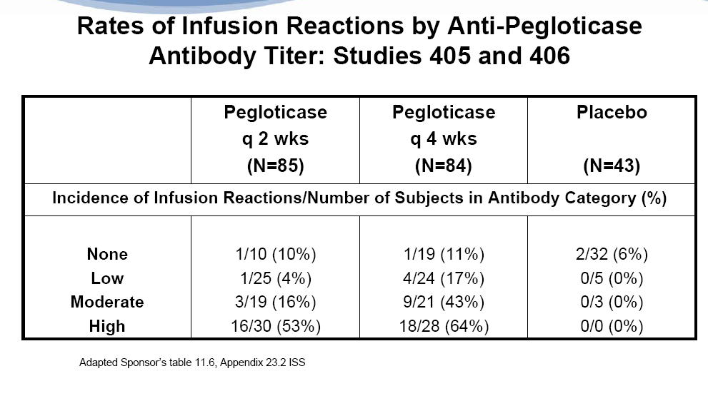
Immunogenicity Titer Association with Infusion Reactions
From Pegloticase FDA Briefing Book

Slide 9
Immunogenicity of other Pegylated Therapeutics*
PEGylation technology successfully generated several FDA-approved compounds which are considered non immunogenic:
PegIntron®
Pegasys®
Neulasta®
Mircera®
* The Open Conference Proceedings Journal, 2011, 2, 104-107

Slide 10
Detection of Anti-PEG Antibodies is Challenging
IgM
Low affinity
Interference from Tween
* “A critical review of the literature shows that most, if not all assays for anti-PEG antibodies are flawed and lack specificity”
* Pharm Res 30: 1729-1734 2013

Slide 11
Use of SPR for Immunogenicity Assessment for Pegylated Proteins
Sample Flow
ADVANTAGES
Detects all classes of Ab
Detects low affinity
Provides specificity
Challenges
Throughput
Cost
Drug Tolerance
Sensitivity?
Native Protein
Pegylated Protein
SPR Flowcells
Using a single assay, SPR can identify antibodies to
native protein and/or pegylated protein

Slide 12
Other Methods for Anti-PEG Antibody Detection
Direct ELISA
Bridging ELISA
ECL

Slide 13
ADC Immunogenicity
Anti-therapeutic antibodies ATAs may be directed against the antibody (mAb) or linker/toxin portion of the ADC
Antibody (mAb):
Sequence
Post-translational modifications
Linker/toxin:
Hapten, mAb provides T-cell help
ADC:
Aggregates, impurities
Linker/toxin
Monoclonal Antibody mAb
Dosing regimen: dose, route, frequency
Subject population: species, immune status, genetic background

Slide 14
Potential consequences of ADC Immunogenicity
Pharmacokinetics
Enhanced immune-complex mediated ADC clearance
Efficacy
ADC Neutralization
Anti-mAb: blocks target binding site
Anti-linker/toxin: formation of large immune complexes prevent cell internalization
Safety/toxicity profile:
uptake of toxin by non-target cells during immune complex clearance may contribute to ADC toxicity (liver/spleen)
→ Robust ADC immunogenicity monitoring strategy

Slide 15
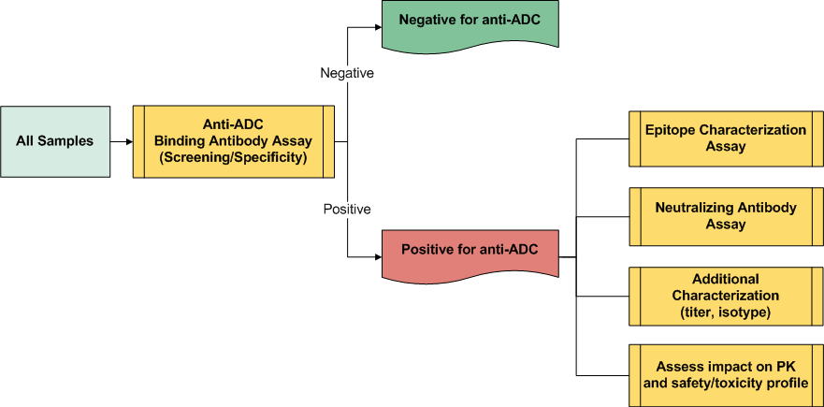
ADC Immunogenicity Testing Strategy
*
*
*
Validated assays recommended for regulated studies

Slide 16
Anti-ADC Binding Antibody Assay: Format/Platform Selection
 | Surface Plasmon Resonance | Direct Capture ELISA, ECL | Bridging ELISA, ECL
Capture | ADC | ADC | Labeled ADC
Detection | Mass accumulation | Secondary reagent anti-species Ig | Labeled ADC
Advantages | ADC labeling not required Detects low affinity antibodies | ADC labeling not required | Specificity, sensitivity, drug tolerance
Disadvantages | Less sensitive and drug tolerant Regeneration conditions must be optimized for ADC | High background Nonclinical assays only | ADC labeling required
Ru
Biotin
SA-HRP
Polarized Light
Reflected Light
Anti-species Ig
ADC
Gold Film
ADC
anti-ADC
Sample Flow
anti-ADC
ADC
ADC
Plate
Biotin
Avidin
MSD Plate

Slide 17
Anti-ADC Bridging Assay: Screening and Specificity
Detection and confirmation of antibodies directed against any portion of the ADC
Screening Assay
Specificity Assay:
Competition with unlabeled ADC
Ru
Ru
ADC
Anti-ADC
(Anti-linker/toxin
or Anti-mAb)
ADC
Biotin
Biotin
Avidin
Avidin
Plate
Plate

Slide 18
Anti-ADC Bridging Assay: Epitope Characterization
Option 1:
Option 2:
Competition with unlabeled mAB or
BSA-linker/toxin
Detection with labeled mAb or BSA-linker/toxin
Ru
Ru
Ru
Anti-mAb
BSA
Anti-linker /toxin
Anti-mAb
Anti-linker/toxin
Biotin
Avidin
BSA
Biotin
Biotin
Plate
Avidin
Avidin
Plate
Plate

Slide 19
Conclusions
Selection of appropriate assay format is crucial for the detection of all anti-ADC immune responses
Characterization is recommended for anti-ADC positive subjects:
Epitope mapping
Neutralizing ability
Robust immunogenicity monitoring strategy is required due to
potential safety / toxicity consequences

Slide 20
SUMMARY
Patients can benefit from novel therapeutics
Improved efficacy
Reduced dosing
Unmet medical needs
Immunogenicity assessment will continue to be important to support these novel therapeutics
Risk-based strategy for assessment
Characterization to better understand the mechanics of the immune response
Continue to develop safer and more efficacious protein therapeutics

Slide 21
Acknowledgements
And of Course…
Amgen’s Clinical Immunology Department
Special Thank You to:
Dr. Mike Moxness
Dr. Marta Starcevic
Dr. Naren Chirmule

